Slide 1
Out of this world: constructing languages for fiction, film, and fun
Laura A. Janda
Lexicon
Sound systems (Phonology)
February 3, 2023 Session B

Slide 2
Lexicon: Good places to start when creating vocabulary
https://en.wikipedia.org/wiki/Swadesh_list
https://cals.info/word/list/

Slide 3
Ways to build lexicon from existing words
Word families
Semantic maps (cf. Conlanger’s thesaurus)

Slide 4
An example of a word family in Russian
poželanie
‘desire’ n.
vozželat’
‘crave’ v.
poželat’
‘wish’ v.
želatel’nyj
‘desirable’ adj.
želatel’nost’
‘desirability’ n.
želat’
‘wish’ v.
želatel’no
‘desirably’ adv.
neželatel’nost’
‘undesirability’ n.
neželatel’no
‘undesirably’ adv.
želaemyj
‘desired’ adj.
želanie
‘wish’ n.
neželatel’nyj
‘undesirable’ adj.
neželaemyj
‘undesired’ adj.
želannyj
‘wanted’ adj.
neželannyj
‘unwanted’ adj.

Slide 5
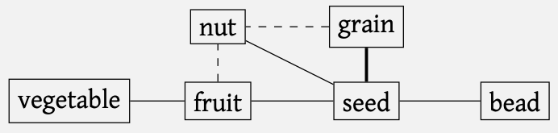
How to read the Thesaurus
Entries, organized according to semantic fields such as
The Physical World, Kinship, Animals, The Body…
Common historical changes: “a word for vessel can → head”
Common grammaticalization paths: “hand n. Gr. ⤳ agent ‘by’”
Semantic maps
Represent pairwise polysemies

Slide 6
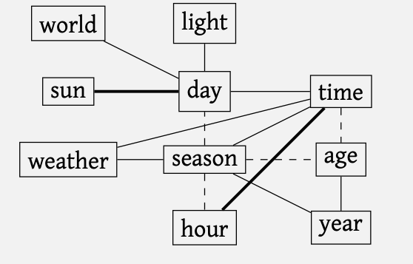
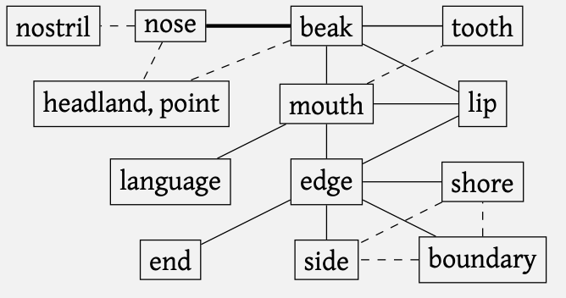

Slide 7
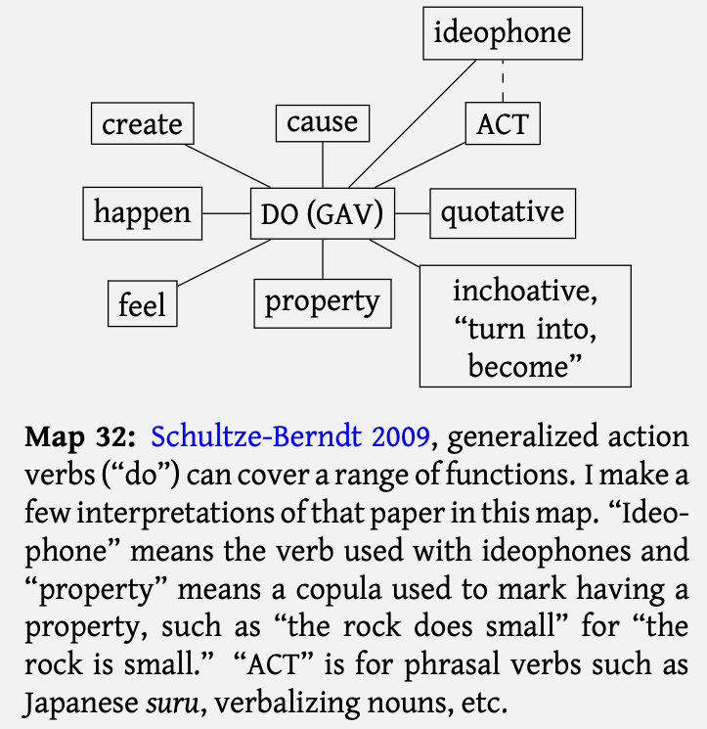

Slide 8
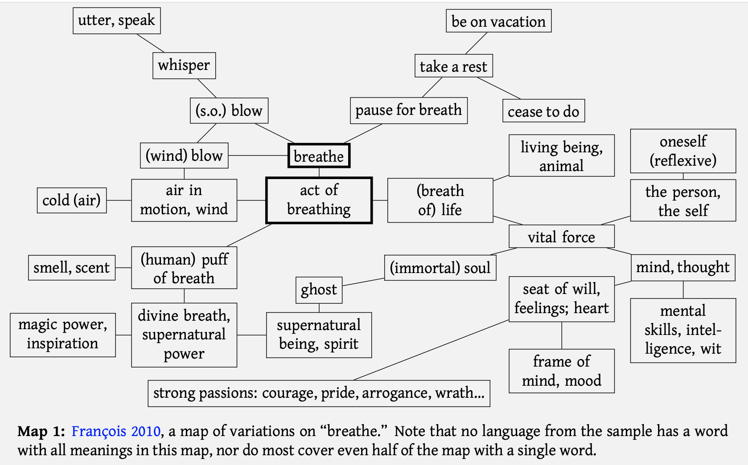

Slide 9

Questions and Comments?

Slide 10
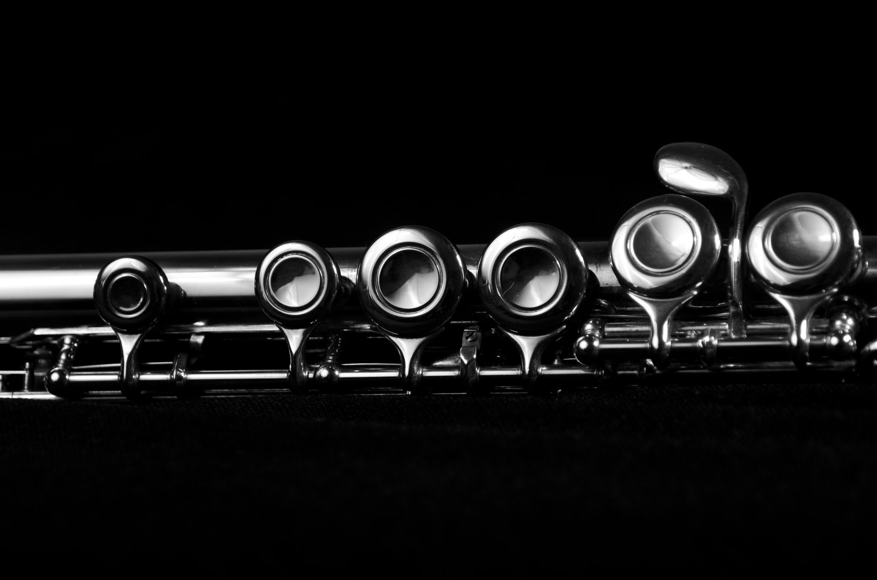
Sound systems: Consonants

Slide 11
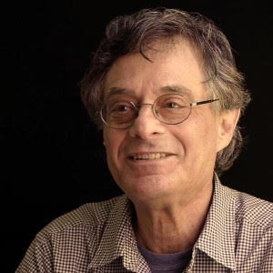
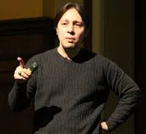
Where to start?
Think about what you want to say!
Phonetics
(physical properties of sounds)
Phonology (sound systems)
Sounds
Morphology
(Grammar: inflection and derivation)
Marc Okrand
(creator of Klingon)
Lexicon
(words and their meanings)
Words
Let’s start with the sounds!
Syntax
How do you want your language to sound?
Sentences
In order to decide how your language should sound, you need to learn about the physical properties of sounds and sound systems in language!
David J. Peterson

Slide 12
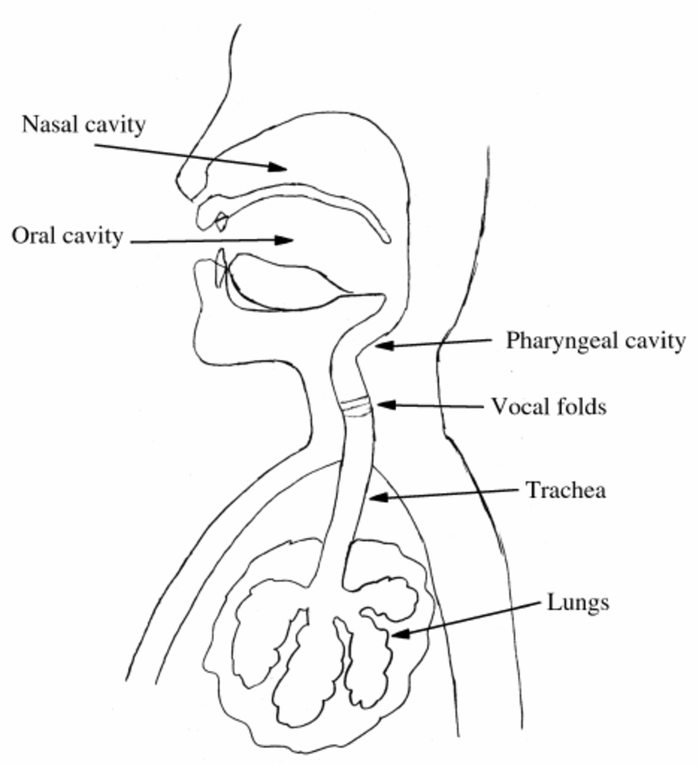
How do humans make speech sounds?
You need air from the lungs
Vowels
Let the air pass through the mouth without impediments
Consonants
Put some sort of obstruction to the air flow.
The result depends on several factors:
Place of articulation – where is the obstruction?
Manner of articulation – what type of obstruction?
Voicing – what goes on in larynx?
Some additional features
Not really!
Do I have “speech organs”?
Larynx
These parts of the body are primarily used for breathing and eating
Language is secondary and does not need sound: signed languages use hands instead

Slide 13

Places of articulation
Alveolar ridge behind upper teeth: Alveolar
Hard palate: palatal
Soft palate (velum): velar
Teeth: Dental
Uvula : Uvular
Lips: Labial
Pharynx (the back of the throat): Pharyngeal
back: dorsal
Each term defines a “natural class”, i.e., a group of sounds that share an important property.
blade: laminal
tip: apical
Glottis: glottal
We can now describe sounds, e.g.:
velar, apico-alveolar, lamino-alveolar

Slide 14
Manner of articulation: How to obstruct airflow
Each term defines a “natural class”, i.e., a group of sounds that share an important property
Oral stop (plosive)
Airflow through mouth is interrupted completely [p, t, k]
Fricative
Tight constriction creates turbulent airflow [f, s]
Affricate
Oral stop + fricative [ts]
Nasal stop
complete innterruption of airflow in the mouth, air through nose instead [m, n]
Glide
a consonantal version of a vowel [w, j]: used as consonants in syllables
Trill (vibrant)
R-sounds involving more than one vibration [r]
Flap/tap
R-sounds involving one single vibration [ɾ]
Lateral
L-sounds where air comes out on the side of the tongue (latus = side in Latin)

Slide 15

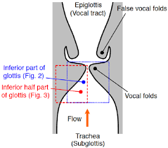
Voicing – what goes on in the glottis?
Glottis = the space between the vocal folds
Vocal folds are like a curtain: when air flows through, they will vibrate
Voiced sounds: [z]
In order to avoid vibration, take the curtains to the side
Voiceless sounds: [s]
Oral stops, fricatives and affricates can be voiced or voiceless
Other consonants (and vowels) are normally voiced.

Slide 16
Consonant systems
≈ apico-postalveolar
 | Labial | Dental | Alveolar | Retroflex | Palatal | Velar | Uvular | Glottal
Oral stop voiceless | p | t̪ | t | ʈ | c | k | q | ʔ
Oral stop voiced | b | d̪ | d | ɖ | ɟ | ɡ | ɢ
Fricative voiceless | f | s̪ | s | ʂ | ç | x | χ | h
Fricative voiced | v | z̪ | z | ʐ | ʝ | Ɣ | ʁ | ɦ
Affricate voiceless | pf | ʦ̪ | ts | ʈʂ
Nasal stop | m | n̪ | n | ɳ | ɲ | ŋ
Glide | Ʋ |  | ɺ |  | j | w
Flap/tap |  |  | ɾ
Trill | ʙ |  | r |  |  |  | ʀ
Lateral |  | l̪ | l | ɭ | ʎ | ʟ
Link to IPA chart with sound
We organize consonants according to natural classes
Result: consonant systems
Notes:
See page 33. The slide is somewhat simplified
IPA chart with sound: https://www.internationalphoneticalphabet.org/ipa-sounds/ipa-chart-with-sounds/

Slide 17
Airstream mechanisms
Pulmonic:
Most consonants are pulmonic with airflow from lungs (Latin: pulmones)
Non-pulmonic (1): implosives
Lower the glottis so that air rushes into the mouth
Non-pulmonic (2): ejectives
Pronounce an oral stop while holding your breath.
Air rushes out of the mouth from glottis, which is closed
Non-pulmonic (3): clicks
Air rushes into the mouth while mouth is closed at velum/uvula.
Only attested in Southern Africa, e.g., Xhosa.
Only attested in the beginning of a syllable
Clip: Conlang-y-er 2:23-5:17

Slide 18
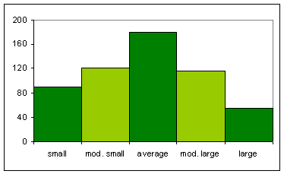
How big are consonant systems?
WALS: survey of 566 languages
NB! Counting is NOT trivial:
Only sounds that distinguish between different words
Not sounds that are only present in recently borrowed words
Minimum: 6
Rotokas (West Bougainville; Papua New Guinea)
/p, t, k, b, d, g/
Maximum: 122
!Xóõ (Southern Khoisan; Botswana)
Lots of clicks in the beginning of words
Average: 22.7
Average systems are found “in most areas of the world” (Maddieson 2013, WALS)
Small: 6-14
Moderately small: 15-18
Average: 19-25
Moderately large: 26-33
Large: 34-122
Notes:
Ian Maddieson. 2013. Consonant Inventories. In: Dryer, Matthew S. & Haspelmath, Martin (eds.) The World Atlas of Language Structures Online. Leipzig: Max Planck Institute for Evolutionary Anthropology. (Available online at http://wals.info/chapter/1, Accessed on 2021-01-21.)

Slide 19
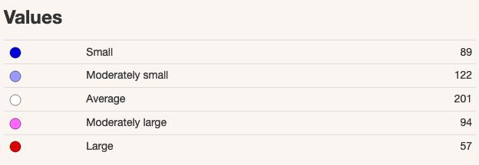
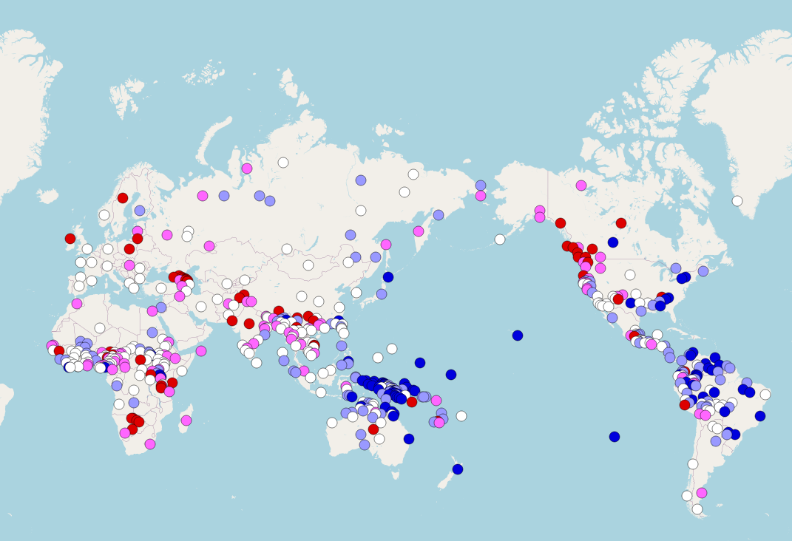
Geographic distribution of consonant systems
Small:
Pacific
Amazon basin
Large:
Southern Africa
Central Eurasia
Northwest of North America

Slide 20
Questions and Comments?

Slide 21
Sound systems: Vowels

Slide 22
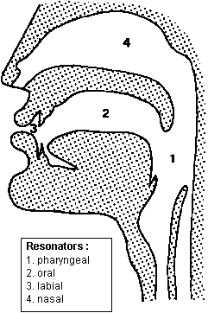
What is a vowel?
Vowel quadrant:
Vowels are born in this space
(sufficiently open for the air to pass unimpeded)
What do we need to pronounce vowels?
Air from the lungs
No impediment in the oral cavity (free passage)
A vowel is a sound where the air is allowed to pass out of the lungs totally unimpeded.

Slide 23
Vowels – how are they different?
What is the difference between [i] and [e]?
Height – how close or far away is the tongue from the roof of the mouth?
What is the difference between [a] and [ɑ]?
Backness – how far is the body of the tongue from the pharynx?
What is the difference between [i] and [y]?
Rounding – are the lips rounded or not?
i
y
ɨ
ʉ
u
e
ø
ə
o
a
ɑ
Natural classes for vowels:
High – mid – low
Front – central – back
Unrounded - rounded
Notes:
Use handout!

Slide 24
What does Peterson mean?
“Vowels are really just buoys on the vast ocean of vocalic possibility!”
Consonants have clearly defined places of articulation.
The vowel space includes no clearly defined boundaries between vowels.
Notes:
p. 42

Slide 25
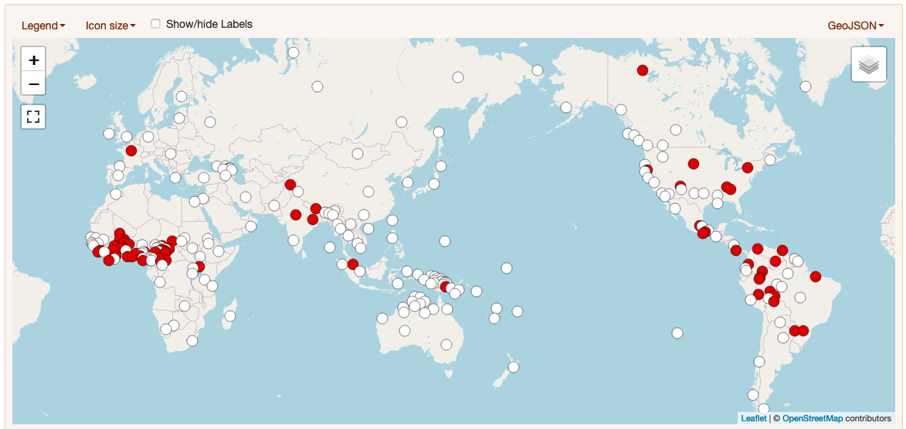
Nasalized vowels across the world
Polish and Portuguese also have nasalized vowels
Nasalized vowels common in certain areas, but otherwise relatively rare
Notes:
WALS

Slide 26
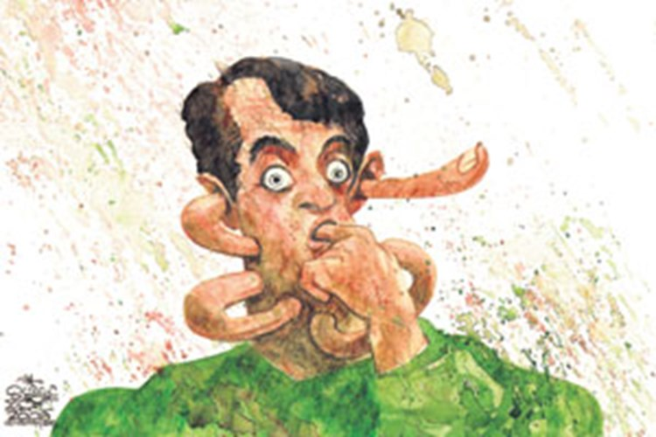
r and l as vowels
In Slovak, r and l can be vowels, both short and long
smrť ‘death’, mŕtvy ‘dead’, dlho ‘long’, dĺžka ‘length’
In Czech, one can pronounce a whole sentence with the vowel r in every syllable:
Strč prst skrz krk!
‘Stick your finger through your neck!’

Slide 27
Questions and Comments?

Slide 28
Sound systems: Phonotactics

Slide 29
Phonotactics
Ancient Greek: phōnḗ ‘voice, sound’ + taktikós ‘arrangement’
A set of norms for the positions and combinations of sounds in a given language
initial, final, internal positions
syllable structure
consonant clusters and vowel chains
assimilation and dissimilation
It is entirely possible that two languages could have the same set of phonemes but very different phonotactics
Clip: Conlanging 1:19-2:10

Slide 30
Phonotactics Example 1: consonant clusters
The cluster [ts] is well-formed in English, German, and Russian
All three languages can have [ts] in final position
Eng streets, Ger blitz ‘lighting’, Rus ulic ‘streets’ (Genitive Plural): all end in [ts]
Only German and Russian can have [ts] in initial position
Ger ziel, Rus cel’ ‘target’: both begin with [ts]
There are many ways to organize
the same sounds in a language

Slide 31
Phonotactics Example 2: voicing assimilation
Voicing assimilation is very common in Slavic languages
In Czech, all consonants in a cluster or a phonological word (a unit with one stress) must be either voiced or unvoiced, determined by the last consonant
It is nearly impossible for Czechs to pronounce clusters with both voiceless and voiced consonants
snapdragon sounds like “snabdragon”, Czech guy sounds like “Czeg guy”
There are many ways to organize
the same sounds in a language

Slide 32
Phonotactics Example 3: vowel harmony
Vowel harmony is particularly common in Turkic and Uralic languages
All vowels in a word share a feature, such as back vs. front
Root | Dative | Gloss
város | város-nak | 'city'
öröm | öröm-nek | 'joy'
In Hungarian, the dative suffix has two different forms: -nak/-nek.
The -nak form appears after the root with back vowels (o and a).
The -nek form appears after the root with front vowels (ö and e).
There are many ways to organize
the same sounds in a language

Slide 33
Syllables
Simple syllable structure:
only CV and V
C = consonant, V = vowel
Most common syllable structures:
CV (in every language)
V
CVC
CCV
VC
and variants
Moderately complex syllable structure:
CV, V, and CVC
or
CV, V, and CCV
Complex syllable structure:
two or more consonants allowed both before and after the vowel
English canonical syllable pattern
(C)(C)(C)V(C)(C)(C)(C),
as in strengths /stɹɛŋkθs/
See WALS Feature 12A on next slide

Slide 34
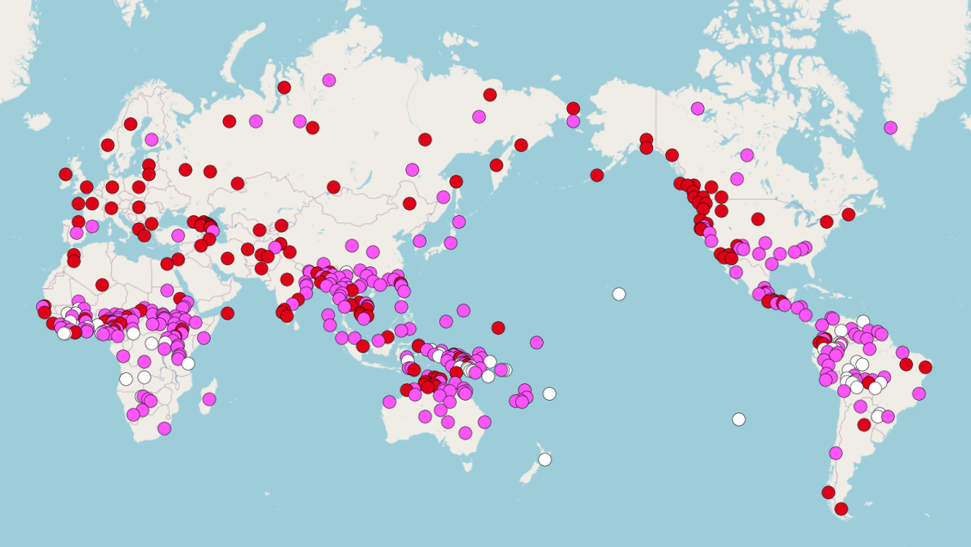
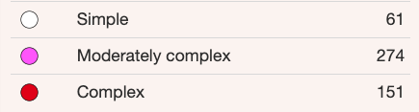

Slide 35
Syllable generators
http://akana.conlang.org/tools/awkwords/
http://www.zompist.com/gen.html
Clip: Conlang-y-er 7:36-9:14

Slide 36
Questions and Comments?

